Slide 1
A Survey on Environmental Awareness, Attitude and Participation
Course Title - R Programming (SEC)
Team Members:
Name: Anusha ,Seetha Vijaya, Soumya Sharma
HT NO: (120422467021), (120422467051), (120422467055)
Program: B.Sc.
Combination: MSCs
Year: II

Slide 2
INTRODUCTION
Earth has limited land and resources that is valuable on which we rely for fiber, food and fuel wood and for the basic needs of sustaining life.
Numerous dangers and issues are happening to the climate, for example, global warming, ozone exhaustion, dry spell, soil disintegration, deforestation, and contaminations which are corrupting our current circumstance.
The vast majority of these consuming environmental issues are happening by human exercises fundamentally. Human beings are routinely misusing environmental resources without appropriate arranging and natural reasoning.
People should be aware of their environment because the individuals who are well educated about the environment can solve the environmental issues and make the right decisions to curb the same. So, environmental awareness is very important in order to know the environmental issues and hence to reduce these issues.
Now more than ever, it is important that we understand the impact out actions on the environment.

Slide 3
OBJECTIVES
This study is conducted to achieve the objectives that are
To study the extent of awareness of people to issues related to environment.
To study the adoption of ecofriendly behaviors and lifestyle.
To study the extent of awareness towards recycling

Slide 4
LITERATURE REVIEW
A Study on the Environmental Awareness of Students Studying at Secondary Level in Government Schools of South Sikkim
By:
Dr. Dona Rai
Ms. Parumita Rai
Environment includes everything that we need for our survival such as air, water, soil, other living organisms etc. Environmental awareness is an ideology that evokes the necessity and responsibility of humans to respect, protect, and preserve the natural world from its anthropogenic afflictions. Hence, this paper is an attempt to understand the attitude of students of Government Secondary School towards environmental protection and the level of awareness they have on the impact of environmental degradation.
Descriptive survey method has been applied to conduct the present study. Population consist of students studying in classes IX and X in various secondary and senior secondary government schools in South Sikkim. Sample of 80 students were drawn out randomly from the population.
Tool used to collect data was Environmental Awareness Ability Measure (EAAM) constructed and standardized by Praveen Kumar Jha (1998) . Collected data were analyzed by applying Pearson’s Coefficient of Correlation.

Slide 5
Mean score was used for each variables to determine the extent of environmental awareness among the sample. The values of standard deviation were used to measure the dispersion of scores in distribution. The t-value (critical ration) was calculated to test the significance of difference in the means of environmental awareness scores for the samples
Conclusion:
1.Majority of the students are having ‘above average’ environmental awareness level and none of them are having ‘extremely low ’or ‘low’ environmental awareness level.
2. Locality does not significantly contribute towards the environmental awareness of students studying at secondary level.
3. Being a boy or a girl does not make much difference in environmental awareness of students studying at secondary level.

Slide 6
DATA AND METHODOLOGY
Data was collected from a questionnaire by a circulating a Google form.
The questionnaire has simple questions like, how much information do people get about the environment from televisions or social networking sites, do they recycle, which techniques do they use to recycle various materials and some questions about the disposal conditions in their neighbourhood areas, and simple environmental awareness questions.
Pie chart, line chart and bar graphs, and Interpretation tables are made for some attributes.
For testing the significance difference between attributes Karl Pearson’s Chi- Square Test is used. For checking the awareness towards the environment, the population is divided into intervals based on their response to some questions the responses are graded. Then this analysis is further analyzed by calculation mean, median and creating a bar chart.
Software used are MS Excel and R Studio.

Slide 7
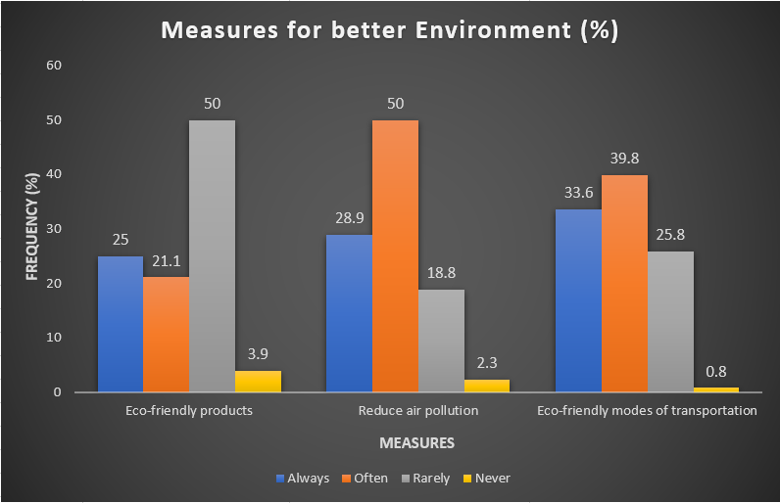
RESULTS (Charts)

Slide 8
Demographic Table
Eco-friendly methods
Parameters | N (%)
Gender Male Female Transgender | 10(7.8%) 118(92.2%) 0
Age 17-20 21-25 26-35 36-45 45+ | 115(88.8%) 7(5.5%) 3(2.3%) 2(1.6%) 1(0.8%)
Highest Education Qualification SSC Intermediate Diploma UG PG | 5(3.9%) 38(29.7%) 3(2.3%) 73(57%) 9(7%)
Parameters | N (%)
Using eco-friendly modes of transportation Always Often Rarely Never | 43 (33.6%) 51 (39.8%) 33 (25.8%) 1 (0.8%)
Choosing products with eco-friendly labels Always Often Rarely Never | 32 (25%) 64 (50%) 27 (21.1%) 5 (3.9%)
Use any renewable energy source at home Yes No | 49(38.3%) 79(61.7%)
Turn off electronics/electrical gadgets when not in use Yes No Sometimes | 104(81.3%) 8(6.3%) 16(12.5%)
Recycling
Parameter | N (%)
Recycling products at home/workspace Always Most of the times About half of the time Once in a while Never | 17 (13.3%) 48 (37.5%) 28 (21.9%) 27 (21.1%) 8 (6.3%)
Regularly recycled items Plastic Glass Paper Batteries Other | 59(46.1%) 30(23.4%) 76(59.4%) 23(18%) 31(24.2%)
The best ways to recycle more often Use double sided copies Use reusable plates, cups or utensils Carry a reusable bottle or coffee mug Avoid plastic packaging | 48(37.5%) 72(56.3%) 37(28.9%) 68(53.1%)

Slide 9
Karl Pearson’s CHI –SQUARE Test
Parameters | p-value | Interpretation
Usage of eco-friendly modes of transportation and Gender | 0.069449659** | There is a significant association (p-value =0.069449659) between usage of eco-friendly modes of transportation and gender at 10% Los.
Disposal of e-waste and Gender | 0.023158666* | There is a significant association (p-value =0.023158666) between disposal of e-waste and gender at 5% of Los.
* significant at 0.05 (5%) level of significance (los)
** significant at 0.1 (10%) level of significance (los)

Slide 10
Analysis for Awareness levels among the respondents
Range | Frequency | %
2-6 | 7 | 5.426
7-13 | 51 | 39.535
14-19 | 66 | 51.163
20+ | 5 | 3.876
Total | 129
Median : 14
Mean : 13.581
Below Average scores: 58
Above Average scores: 69
~Symmetric
Karl Pearson’s Chi-square test:
Environmental Awareness and age, P-value = 0.0004
Significant at 0.05 (5% ) level of significance (los)
SCORE (2-6) → Nature Novice: Limited knowledge and engagement with environmental issues.
SCORE (7-13) → Eco-Learner: Actively seeks understanding and solutions for environmental challenges.
SCORE (14-19) → Green Guardian: Makes conscious choices and advocates for environmental protection.
SCORE (20+ ) → Earth Whisperer: Deeply connected to the environment and actively works for its well-being.

Slide 11
APPENDIX (Questionnaire)
Q1. How often do you read or watch news related to environmental issues?
Daily b) Weekly c) Monthly d) Rarely
Q2. Are you aware of impact of deforestation on environment?
Very aware b) Somewhat aware c) Neutral d) Unaware
Q3. Do you believe protecting biodiversity is critical for a healthy environment?
Strongly agree b) Agree c) Neutral d) Disagree e) Strongly disagree
Q4. Are you aware of negative impact of human activities on wildlife?
a) Yes b) no
Q5. How do you feel about the impact of human activities on wildlife habitat?
a) Very Concerned b) Concerned c) Unconcerned d) Very Unconcerned
Q6. Do you know that water pollution harms aquatic wildlife?
a) Yes b) No c)Maybe
Q7. To what extent do you feel individual actions can contribute to minimizing the negative impact on wildlife?
a) A lot b) Somewhat c) Neutral d) Not much e) Not at all
Q8. How often do you choose products with eco-friendly labels?
Always b) Often c) Rarely d) Never
Q9. Do you conserve water at home?
Always b) Often c) Rarely d) Never

Slide 12
Q10. Do you take measures to reduce air pollution in your daily life?
a) Always b) Often c)Rarely d) Never
Q11. In which of the ways do you conserve water where you live?
Limit shower time b) Turn of the sink while hand washing, shaving etc. c) Only wash full loads of laundry d) Others
Q12. Do you take measures to reduce air pollution in your daily life?
a) Always b) Often c) Rarely d) Never
Q13. How often do you use eco-friendly modes of transportation (walking, using electric vehicles and bicycles)?
a) Always b) Often c)Rarely d) Never
Q14. How frequently do you recycle products in your home/workspace?
a) Always b) Most of the time c) About half of the time d) Once in a while e) Never
Q15 What type of items do you regularly recycle?
a) Plastic b) Glass c) Paper d) Batteries e) Other
Q16. How do you dispose of electronic waste?
a) Recycle b) Donate c) Throw in regular trash d) Other
Q17. Do you believe that more usage of papers impacts environment?
Yes b) No
Q18. Do you think recycling plays a role in conserving natural resources (trees etc.)?
Yes b) No c) May be

Slide 13
Q19. In your opinion, what are the best ways to encourage the community to recycle more often?
a) Use double sided copies b) Use reusable plastics, cups, utensils c) Carry a reusable bottle or coffee mug d) Avoid plastic packaging
Q20. What is the most important environmental issue in your neighbourhood in your opinion?
a) No proper sewage treatment b) No availability of trash cans and dustbins c) Deforestation d) Air pollution (fire crackers, industries)
Q21. Do you use any renewable energy source at home? (Wind energy etc.)
a) Yes b) No
Q22. Are biodegradable pads are readily available in your local store? How satisfied are you with the effectiveness of Biodegradable menstrual pads compared to traditional once?
a) Very satisfied b) Satisfied c) Neutral d) Dissatisfied e) Very dissatisfied
Q23. To what extent do you think that making a human activity environmentally aware and friendly is more important than increasing economic performance?
a) To full extent b)To large extent c)To moderate extent d) To little extent e) Not at all
Q24. Are you aware of technological innovations aimed at promoting environmental sustainability?
a) Yes b) No
Q25. Are you involved in any local environmental groups or initiatives?
a) Yes b) No
Q26. Do you believe individuals can influence environmental policies?
a) Yes b) No
Q27. Do you turn off electronic/electrical gadgets when not in use?
a) Yes b) No c) Sometimes

Slide 14
Links:
Google Forms Questionnaire
https://forms.gle/FZHrCZLnsFdRDchJ6
Literature Review
https://ijepr.org/download.php?id=711

Slide 15

THANK YOU

